Slide 1

INTRODUCTION
What Is FDM?
FDM (Frequency Division Multiplexing) : is a data communication technique that enables simultaneous transmission of multiple signals by dividing the available frequency bandwidth into non-overlapping bands.
Key points
Multiplexing: FDM allows multiple signals to be combined onto a single transmission medium.
Simultaneous Transmission: FDM enables simultaneous transmission of multiple signals over the same communication medium.
Applications: FDM is commonly used in various communication systems, including traditional analog telephone lines, radio broadcasting, and cable television.
Challenges: It may face challenges such as crosstalk between channels if not properly managed.

Slide 2

PROCEDURES
Two 8-bit binary digital data was taken.
These two 8-bit binary data was passed through ASK modulation separately using the ASK modulation process.
The result analog signal of the input digital signal was plotted in a graph.
The analog signals were then passed to the FDM modulation process by converting them into one composite signal.
The composite signal was plotted on the graph.
The composite signal was de-modulated using FDM process to recover the old analog signal using low-pass filter and other processes.
The recovered analog signal was plotted on the graph using figure plotting techniques.
Finally, binary data was retrieved from the analog signal and shown in command line.

Slide 3

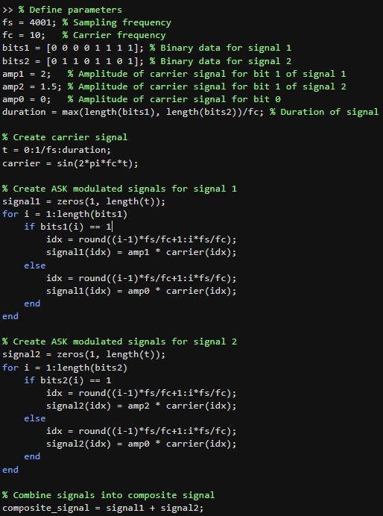
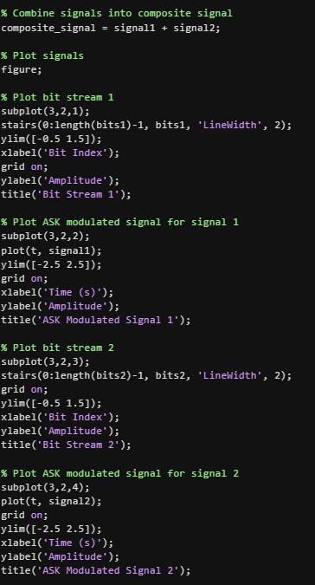
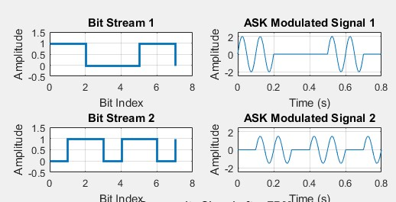
RESULTS
Binary to Analog Signal Conversion using ASK

